Slide 1
Maths engagement – what’s the story?
Using a narrative to get kids involved in a maths task
Bruce Ferrington

Slide 2
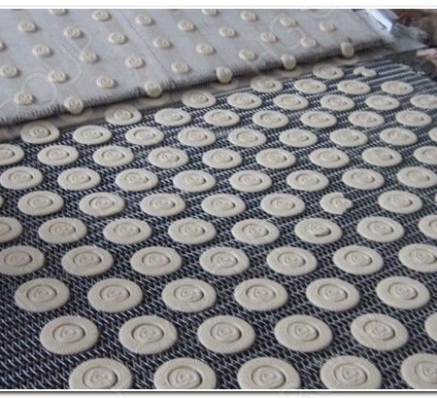
Chocolate Chip Cookies

Slide 3
The stories we tell help students integrate their mathematical experience with their understanding of the human condition.
Selby, V. M. (2009). Story telling Adds. Meaning. The Mathematics Teacher, 102(8), 592–598.

Slide 4
Chocolate Chip Cookies
Story:
At the Heavenly Choc Chip Cookie Company we guarantee at least 7 choc chips in every cookie.
There are 10 cookies in a packet.

Slide 5
Chocolate Chip Cookies
Task:
What if there were only 6 cookies with 3 choc chips in each?
Make a prediction of how many choc chips you would need.
Let’s play the game.
Instructions:
- roll the dice
- add a counter (choc chip) to the cookie of that number
- keep rolling until all cookies have at least 3 “choc chips”
Strategic move:
- try an easier question

Slide 6
Chocolate Chip Cookies
Task:
Back to the original question: 7 choc chips in 10 cookies.
Is it possible to get an “answer”?
Is that a problem?

Slide 7
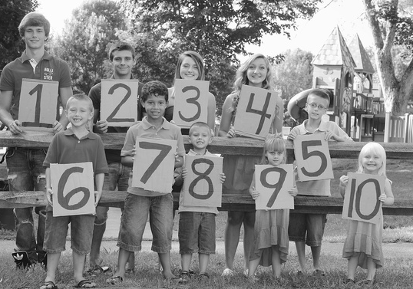
NUMBER FAMILY

Slide 8
NUMBER FAMILY
Story:
The children of the Number family have bedrooms that are allocated in ascending order.
The parents learn, too late, that the children will fight with their chronologically adjacent siblings if they are in adjacent bedrooms.
1 | 2
3 | 4 | 5
6 | 7 | 8
 | 9 | 10

Slide 9
NUMBER FAMILY
Task:
Organise the bedrooms so that consecutive children are not adjacent (vertically, horizontally or diagonally)
1 | 2
3 | 4 | 5
6 | 7 | 8
 | 9 | 10

Slide 10
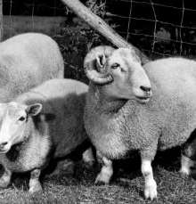
Eric the Sheep

Slide 11
Eric the Sheep
Story:
Eric the sheep is very clever.
He gets impatient waiting in line for his turn to get shorn.
He will jump ahead one place while the shearer is dealing with another sheep.

Slide 12
Eric the Sheep
Task:
Use the counters to work through different possible combinations.
What observations can you make?
What predictions can you make?

Slide 13
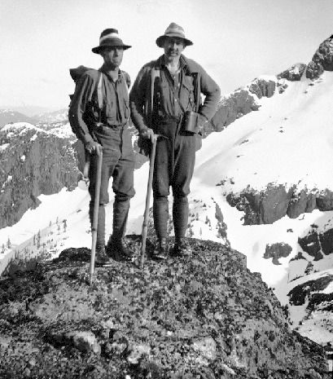
First Down the Mountain

Slide 14
Story:
The Paradise Mountaineering Society has an annual race down Mount Grumbly.
Members start at different points on the mountainside.
They roll 2 dice and move down the mountain if they roll their number.

Slide 15
First Down the Mountain
Task:
Play the game.
What does it look like with a bigger sample? Why?
If we change the length of the race, what will happen? What is the maths behind this?

Slide 16
Licorice Factory

Slide 17
Licorice Factory
Story:
One morning at the Lovely Licorice Factory, the machine Number 6 breaks down.
The boss offers one weeks worth of licorice if anyone can work out how to provide the order for the next day.

Slide 18
Licorice Factory
Story:
Once he has got rid of one machine, he is starting to think that there might be other machines to get rid of.
He offers ONE YEAR’s worth of licorice to the worker who can work out which machines to get rid of.

Slide 19
Licorice Factory
Task:
Which machines can the boss get rid of?
Cross out the machines that are no longer needed and record how you will now make the lengths without that machine.

Slide 20
Mushroom Hunt

Slide 21
Mushroom hunt
Story:
I go mushroom picking with my grandfather and four cousins. Each of us has a basket. When we return, we compare the number of mushrooms in the baskets. We discover two things:
- Adding up the numbers gives a total of 63.
- Grouping the baskets in different ways gives sub-totals equal to every number from 1 to 63.
The problem is how many mushrooms are in each basket?

Slide 22
Mushroom hunt
Task:
How many mushrooms are in each of the 6 baskets?

Slide 23
Thank you for coming today. We look forward to sharing the journey.

